Slide 1
HELLEBORUS NIGER
DR. Gokul krishna. K
Asst. professor ,dept. of Materia Medica

Slide 2
INTRODUCTION
Proved – Dr. Hahnemann
Helleborus dervied from the vegetable kingdom – christmas rose
Family – Ranunculaceae
Christmas rose because the flower blooms in mid winter
Mother tincture is prepared from the dried root

Slide 3
SPHERE OF ACTION
Brain, nervous system, meninges, kidney, serous membrane, urinary organs, gastro intestinal tract

Slide 4
CONSTITUTION
Weak and delicate persons, esp. children who are prone to brain troubles with serous effusion
Temperament – Irritable
Chilly patient
Psora miasm

Slide 5
GUIDING SYMPTOMS
Patients is irritable and easily angered; does not want to be disturbed
Consolation aggravates most of complaints
Brain symptoms during dentition with threatened effusion
Meningitis with exudation and paralysis

Slide 6
Convulsion with extreme coldness of body
Diarrhoea during hydrocephalus or dentition or pregnancy. Stool contains jelly like frog- spawn; involuntary stool
Coffee ground urine, red, black and scanty suppressed and albuminous

Slide 7
Dropsy of brain, chest and abdomen after intermittent fever with debility and suppressed urine
Aggravation 4 to 8 pm (LYCO)
A/F – Dentition period, pregnancy or from suppressed exanthema

Slide 8
HEAD
In diseases of the brain and meninges, such as meningitis, encephalities hydrocephales
Forehead wrinkled in folds. Cold sweat. Stupefying headache. Rolls head day and night; moaning, sudden screams. Bores head into pillow; beats it with hands. Dull pain in occiput, with sensation of water swashing inside. Headache culminates in vomiting.

Slide 9
The patient bores head into pillow, rolls head from side to side beats the head with hands
Patient also constantly picks his lips, clothes or bores the nose with his fingers
There is stupefying headache, forehead has wrinkled folds and is covered with sweat
Dull pain in occiput, headache may culminate in vomiting

Slide 10
Physical make up

Slide 11
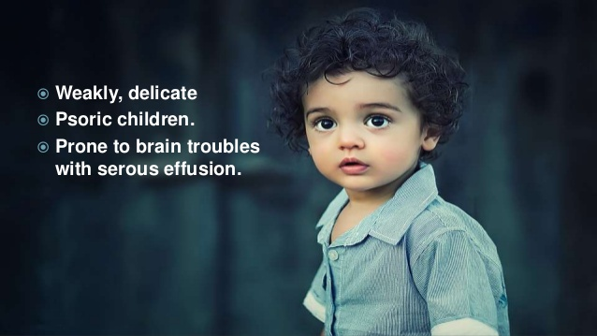

Slide 13
MIND

Slide 16
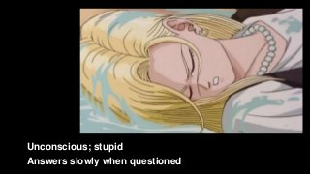

Slide 17
HEAD

